Slide 1
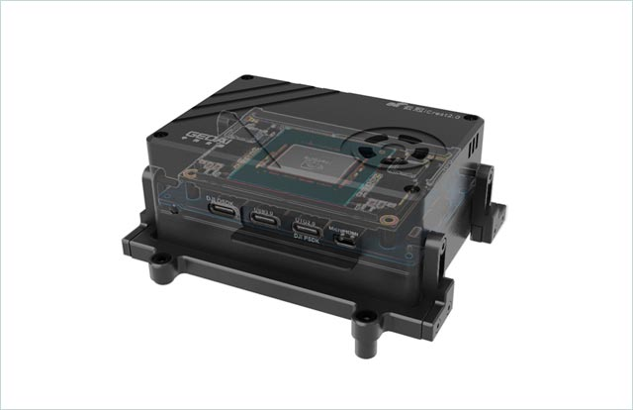
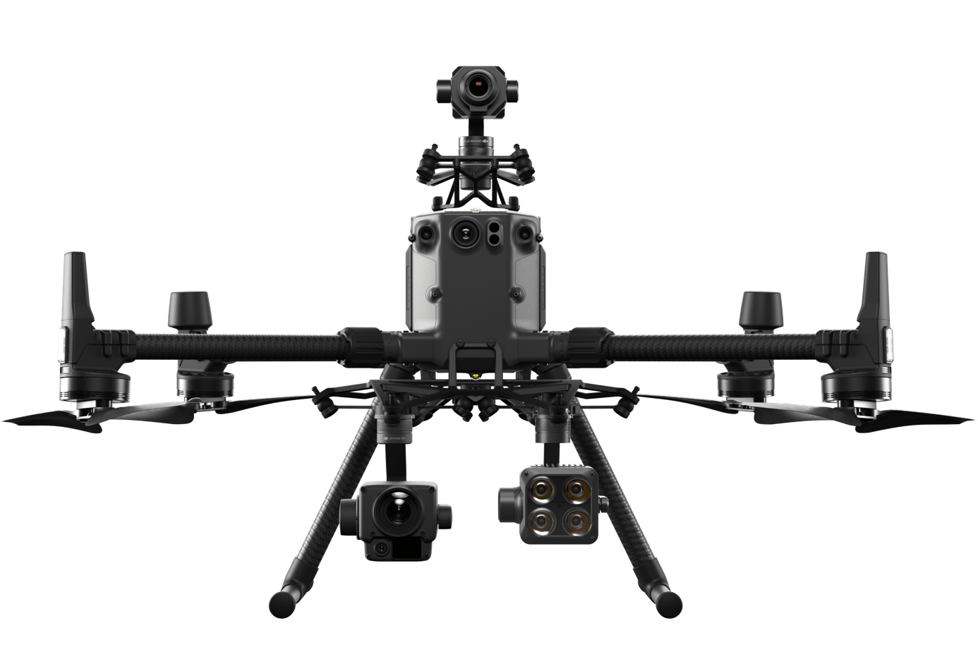
Architecture:
downwards
CV applications
navigation
upwards
ROS + Onboard-SDK-ROS
Onboard-SDK(as a lib)
Linux
IR&RGB Camera
Autopilot
Flight Sensors

Slide 2
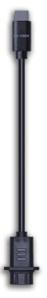
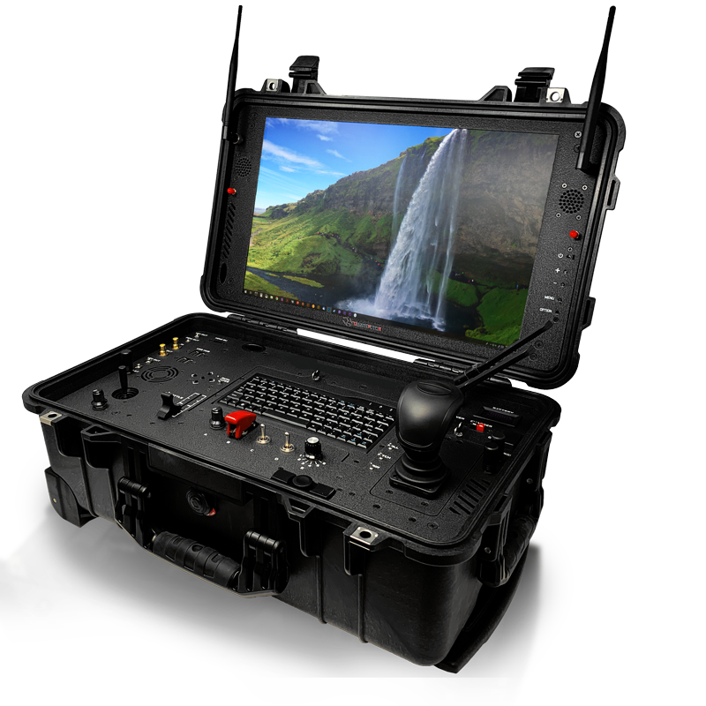
Mission Control
Image Process
Geolocaton
...
ROS + Onboard-SDK-ROS
Onboard-SDK
Ubuntu18.04 (ARM v8)
Flight Control
Payload Control
Sensor Manage
Mission control & Monitor
Images Process
...
ROS
Ubuntu18.04 (X86)

Slide 4
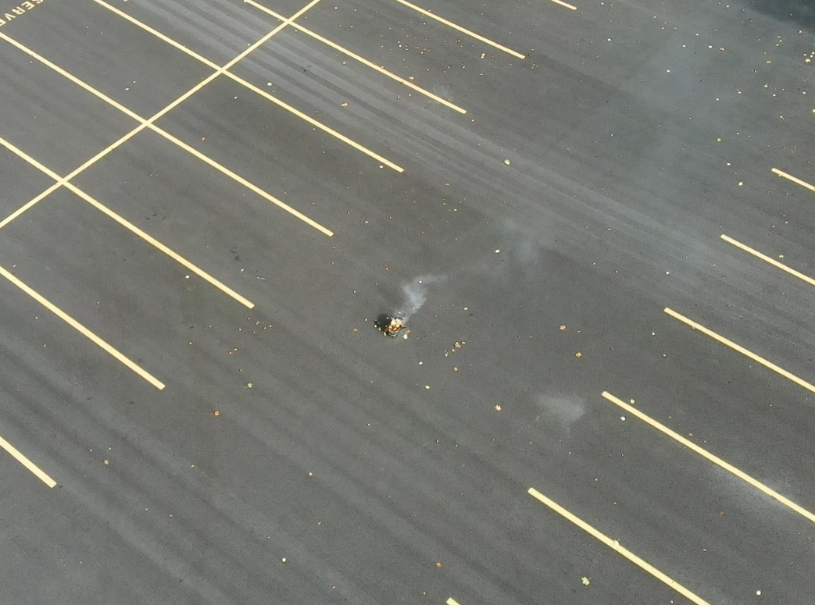
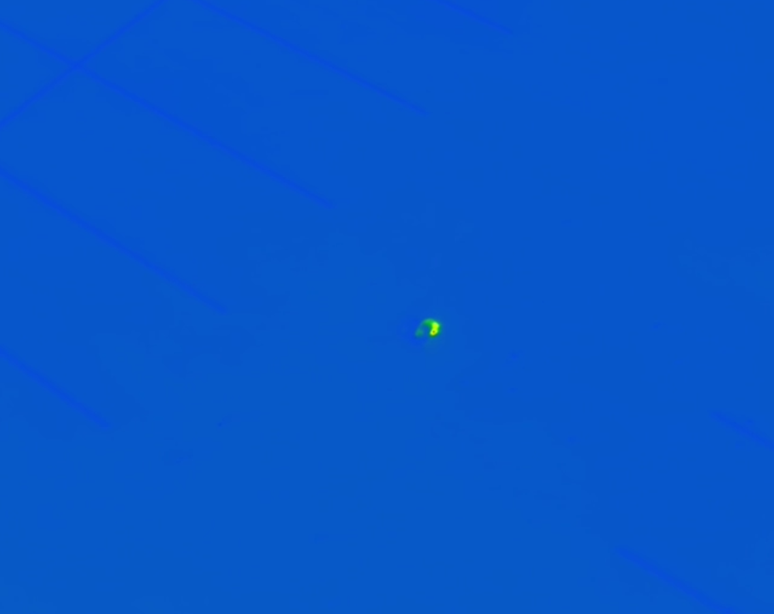
RGB & Thermal Images Captured at the same time stamp
Thread 1
Thread 2
RGB Image-based Detector
Thermal Image-based Detector
P
N
P
N
PP
PN
NP
NN
P
positive
Use the thermal location
Using a lower threshold
Negative
N
negative

Slide 5
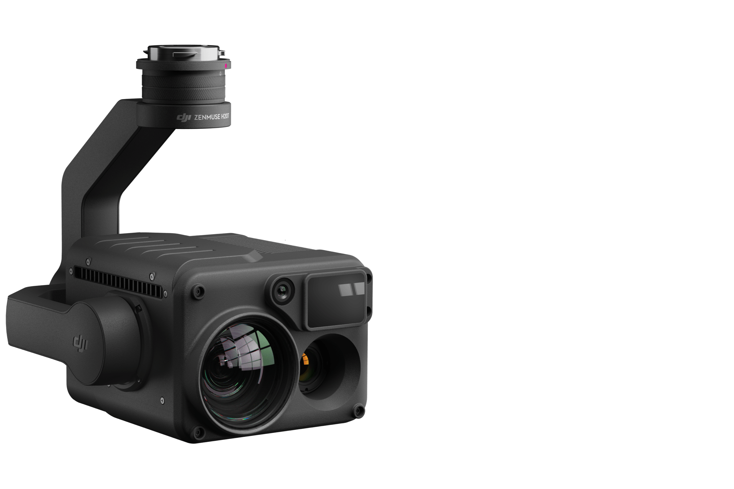
Gimbal
Wide Camrea
Lisar Rangefiner
Infrared Camera
Zoom Camera

Slide 7
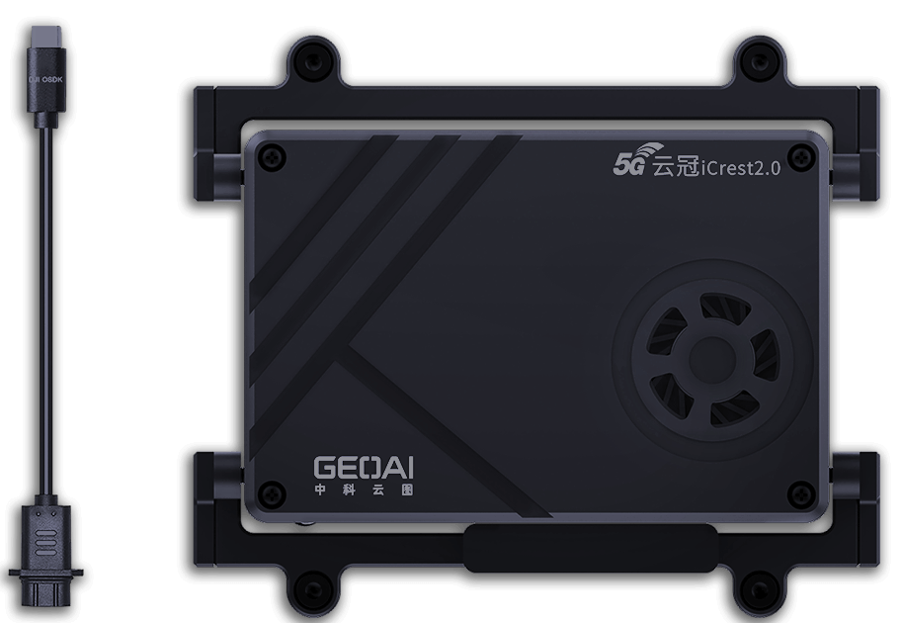

Slide 8
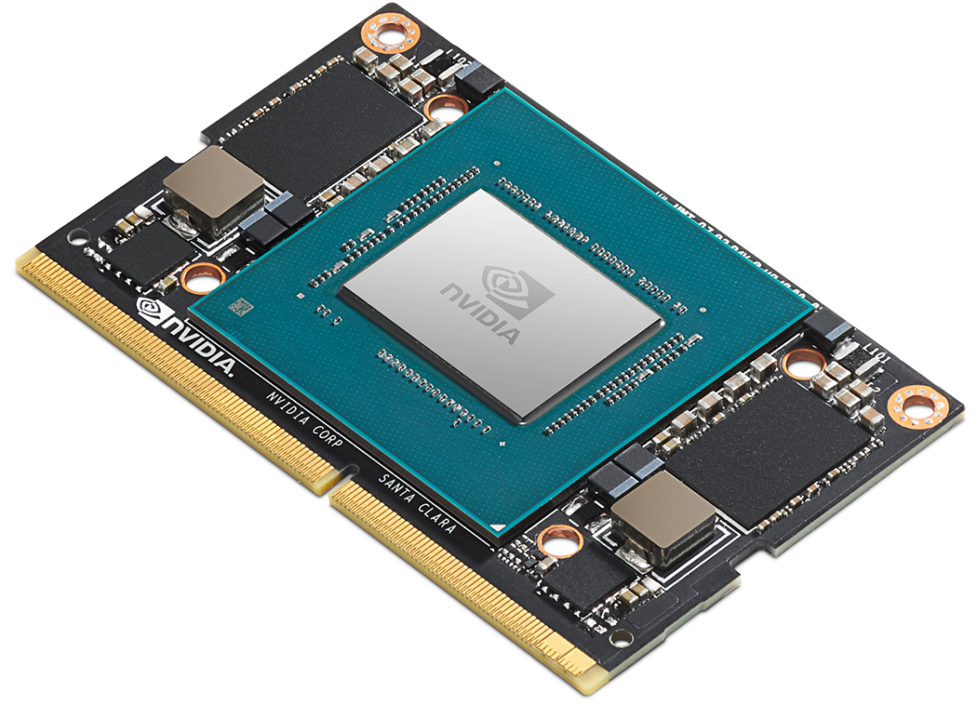

Slide 9
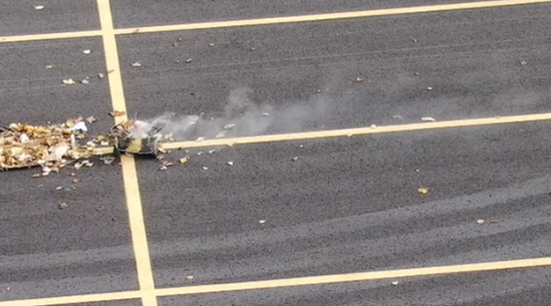
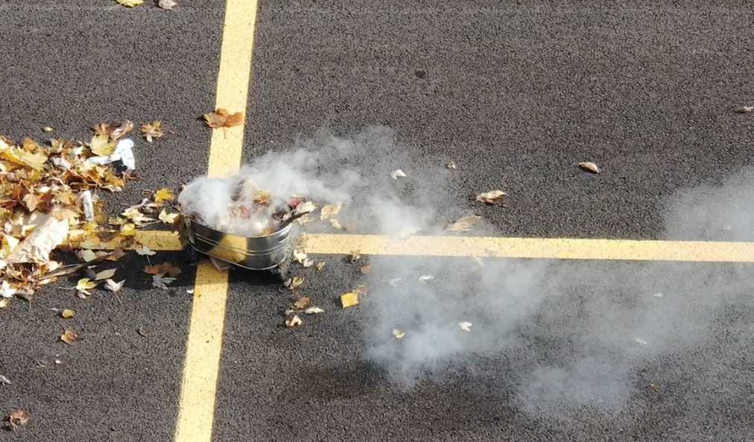
2x
5x

Slide 10
Output
FCN
Output
Average Pool
Block 4
Block 3
Residual x2
Weight Layer
Block 2
Down Sample
Weight Layer
Block 1
Input
MaxPool
3x3, stride=2
Conv
7x7, 64, stride=2
Input

Slide 11
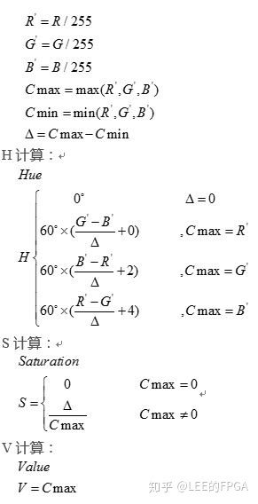
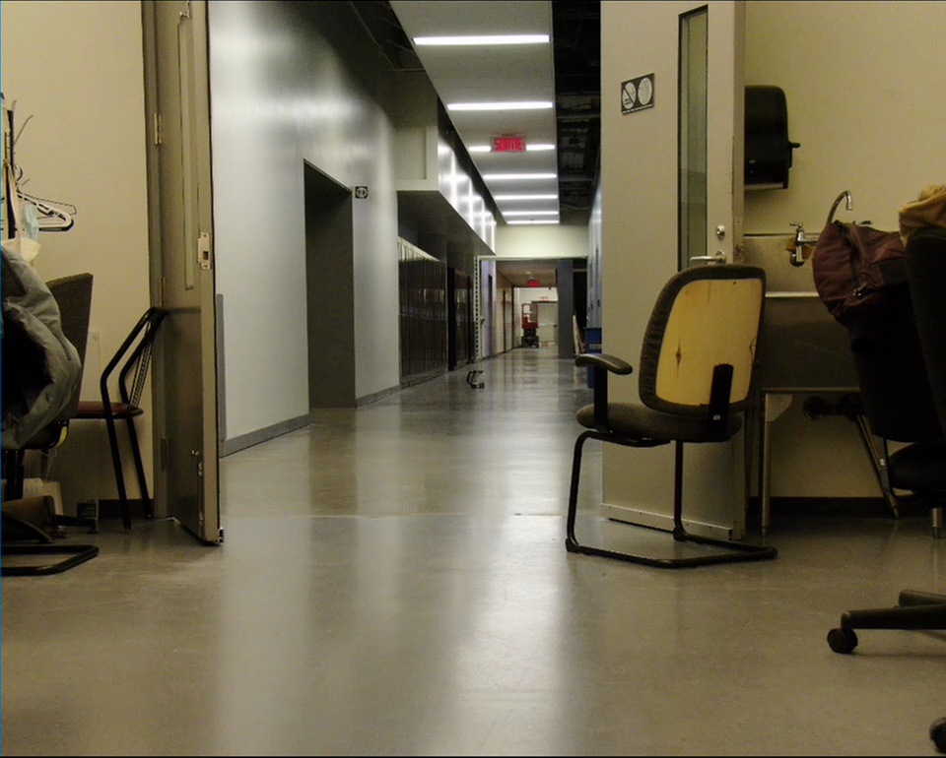

Slide 12
Sliding Window
Potential Heat
1
2

Slide 13



N
$$α$$
$$β$$
E
d
D

Slide 14
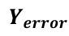
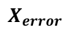

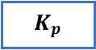

$$X_{error}$$
x
y
$$K_{p}$$
DJI Gimbal Control
$$Y_{error}$$
$$K_{d}$$
$$s$$

Slide 15
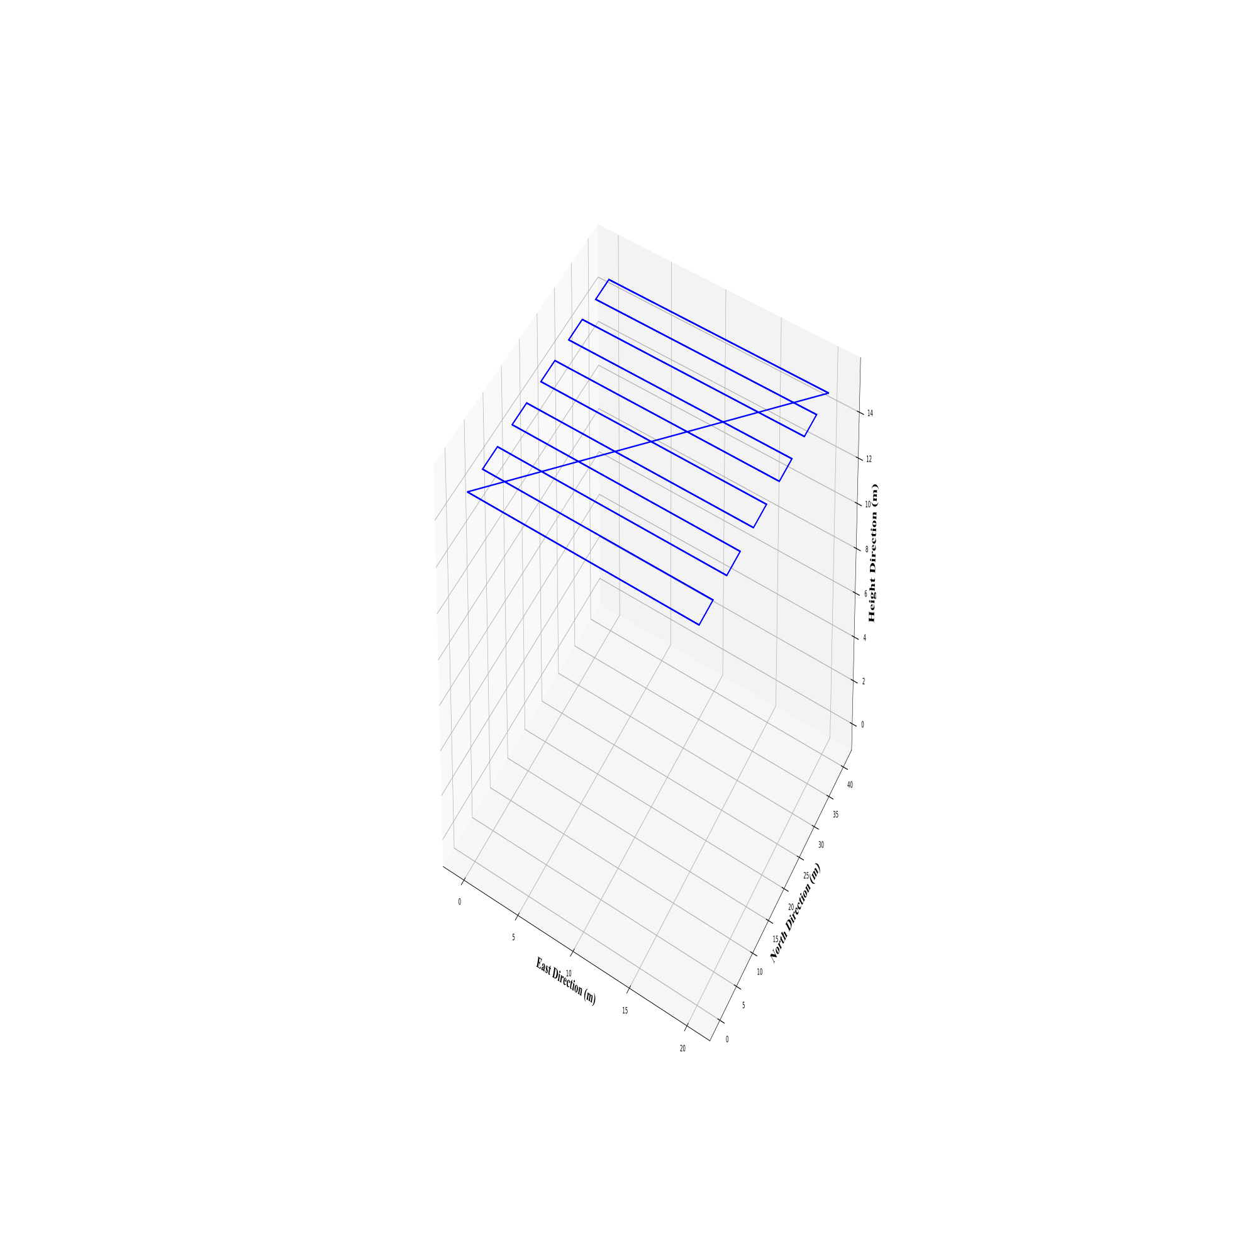

Fire Detected
Home Position

Slide 16
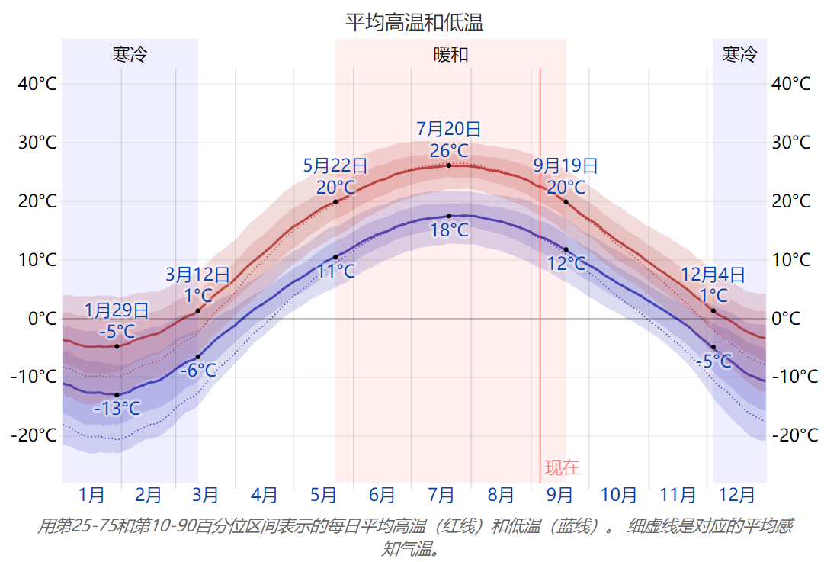
Climate:
By the end of the October, the daytime highest temperature is only around 10°C

Slide 17
Tasks (Objects)&Timetable:
Communication
Read the state estimation data( height, velocity, acceleration, attitude, latitude, longitude, etc.) Send the test command to the camera and autopilot, check the responding.
Read, store, covert the RGB and IR images
Waypoint flight
Waypoint flight simulation
Accomplish some given mission( take a photo, drop something, etc.) at a certain waypoint
Fly along the given path and take the picture(RGB and IR) of the synthetic fire and smoke(an oven, if possible)
Fire and smoke detection
Implement the fire and smoke detector which runs on the onboard computer.
DJI M300 flies along the path and detects the synthetic fire and smoke along the path
Detection and Navigation
Detect fire and Navigate around the fire according to some given strategy
Motion control under the navigation module after the fire is detected.

Slide 18
Tasks (Objects)&Timetable:
Steps | Test Type | Sub-task | Beginning Time | Ending Time | Backup
Communication | ground | Read the state estimation data( height, velocity, acceleration, attitude, latitude, longitude, etc.) | 2021/9/8 | 2021/9/12
 | ground | Send the test command to the camera and autopilot, check the responding | 2021/9/13 | 2021/9/16
 | ground | Read, store, covert the RGB and IR images | 2021/9/17 | 2021/9/22
Waypoint flight | ground | Waypoint flight simulation | 2021/9/23 | 2021/9/28
 | ground | Accomplish some given mission( take a photo, drop something, etc.) at a certain waypoint simulation | 2021/9/29 | 2021/10/1
 | Flying | Fly along the given path and take the picture(RGB and IR) of the synthetic fire and smoke(an oven, if possible) | 2021/10/3 | 2021/10/4 | 1. prepare the flight test first. 2. arrange data set on the second day
Fire and smoke detection | ground | Implement the fire and smoke detector which runs on the onboard computer. | 2021/10/5 | 2021/10/10 | design the detector earlier.
 | ground | Test and debug the algorithm embedded with the picture that are captured before. | 2021/10/11 | 2021/10/18
 | ground | ground simulation | 2021/10/19 | 2021/10/22
 | Flying | DJI M300 flies along the path and detects the synthetic fire and smoke along the path | 2021/10/25 | 2021/10/26 | 1. prepare the flight test first. 2. arrange data set on the second day
Detection and Navigation | Flying | Detect fire and Navigate around the fire according to some given strategy | ~ | ~
 | Flying | Motion control under the navigation module after the fire is detected. | ~ | ~

Slide 19
